Slide 1
THE SELF-TRANSFORMING SCHOOL Launch seminars in Melbourne (August 19), Sydney (August 23), Canberra (August 26)
Professor Brian Caldwell
Managing Director, Educational Transformations
Professorial Fellow, University of Melbourne
Jim Spinks
Director, All Across the Line
Consultants in Educational Reform

Slide 3
The book spans 50 years
1988
Self-Managing School
2013
Self-Transforming School
2038

Slide 4

Research, policy and practice in 11 countries on 6 continents
Canada
Finland
England
United States
China: Shanghai Hong Kong
India
Singapore
Brazil
South Africa
Australia
New Zealand

Slide 5
What is a self-managing school?
A self-managing school is one to which there has been decentralized a significant amount of authority and responsibility to make decisions on the allocation of resources within a centrally-determined framework of goals, policies, curriculum, standards and accountabilities. Resources are defined broadly to include staff, services and infrastructure, each of which will typically entail the allocation of funds to reflect local priorities. A self-managing school has a high level of, but not complete autonomy, given the centrally-determined framework.

Slide 6
What is a self-transforming school?
Whereas a capacity for self-management is chiefly concerned with process, self-transformation is intended to shift the focus to outcomes. A self-transforming school achieves or is well on its way to achieving significant, systematic and sustained change that secures success for all of its students regardless of the setting.
The self-transforming school ‘calls the shots’ even though it draws on the support of and is involved in partnerships with others. Apart from distributing funds on an equitable basis, providing infrastructure and assisting in times of crisis, the main role of an education department is to help build the capacity of all schools to be self-transforming.

Slide 7
Chapters in The Self-Transforming School
Foreword by Dame Pat Collarbone,
Director, Creating Tomorrow
Narratives in Self-Management
Expectations and impact of self-management
Unchaining the Self-Managing School
A study of contrasts in the West
Can the West catch up?
Possibilities for the powerhouses
Contours of change
Innovation everywhere
The transformation of learning
Financial capital and transformation
Funding models and their fitness for purpose
Rediscovering social and spiritual capital
The knowledge
Governance ethos leadership policy
Narratives in self-transformation

Slide 8

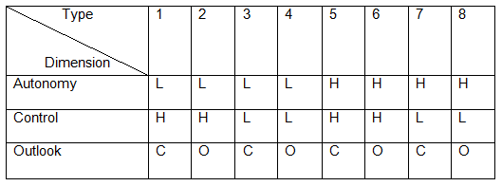
Chaining the self-managing school

Slide 9

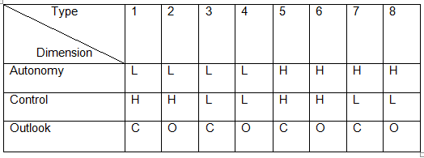
Unchaining the self-managing school

Slide 10
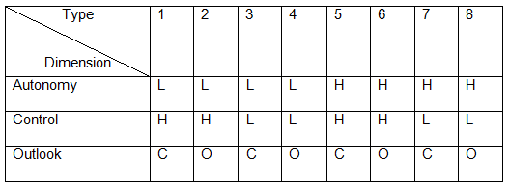

From self-management to self-transformation

Slide 11
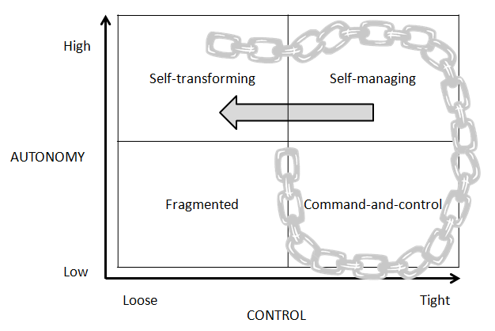
The simplified model

Slide 12
Federal role in education
There is a strong case for changing governance arrangements in countries with a federal system and where powers to make education lie with states or provinces. Powerful roles for federal governments that involve a complex system of conditional grants to state governments that are constitutionally responsible for schools have not been associated with improvement in educational performance. Why not follow the lead of high-performing Canada where, with few exceptions, there is no role in education for the federal government?
Competition between states may result in more innovative and effective approaches to improvement in outcomes. Innovation will be disseminated as a matter of course if states are open to ideas, policies and practices in other jurisdictions. There is no evidence that different states will not pursue the national interest under these circumstances.

Slide 13
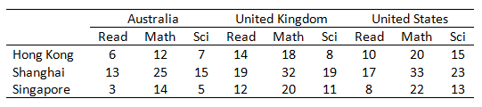
Can the West catch up?
The number of months that students in Australia, United Kingdom and United States are behind 15 year old counterparts in Hong Kong, Shanghai and Singapore in reading, Mathematics and Science (adapted from OECD 2011)

Slide 14
Leading edges of innovation (Chen 2010)
The Thinking Edge: Turn ‘either/or’ debates into ‘both-and’ syntheses. Chen lists ten; for example, rather than teacher-centred instruction or student-centred learning he offers a synthesis.
The Curriculum Edge: The curriculum edge represents the growing trend of transforming and reorganising the most fundamental educational activities; what students are taught and how their learning is assessed.
The Technology Edge: Until every student has his or her own computer, the benefits of using them on a regular, ongoing basis are undercut.
The Time/Place Edge: Represents the destruction of the old view of education happening within the four walls of the classroom.
The Co-Teaching Edge: Partnerships with others who can support the effort, including parents, professionals in other fields and students.
The Youth Edge: Today’s students are marching through our schools, carrying a transformational change in their pockets in the form of powerful handheld devices.

Slide 15
Mapping the leading edges of innovation (devised by the authors using classifications proposed by Chen 2010)
Edge | Continuum
Thinking | Either / or Both / and
Curriculum | Traditional 21st Century
Technology | Few empowered Many empowered
Time / place | Place bound Any time, any place
Co-teaching | Mainly teachers Partnerships of many
Youth | Students passive Students active

Slide 16
Implications for policy and practice
The ‘leading edges’ of innovation that will cohere to enable the transformation of learning to occur have been identified. Schools can make plans accordingly and map their progress, even though the details may not be known, even in the short term.
Despite the large effort and substantial costs involved, a national curriculum or a core curriculum will soon give way to a global curriculum of a kind that the self-transforming school can choose from or adapt, or it can develop its own.

Slide 17
Implications for policy and practice
The ‘leading edges’ of innovation that will cohere to enable the transformation of learning to occur have been identified. Schools can make plans accordingly and map their progress, even though the details may not be known, even in the short term.
Despite the large effort and substantial costs involved, a national curriculum or a core curriculum will soon give way to a global curriculum of a kind that the self-transforming school can choose from or adapt, or it can develop its own.

Slide 18

The Knowledge
London taxi drivers must learn 320 routes and the location of 25,000 streets and 20,000 landmarks before they are licensed. It may take up to three years for ‘the knowledge’ to be acquired. No analogy is intended, although the imagery may be transferred to the school setting to the extent that there may be 320 or more routes or pathways for students in a school if their needs, interests, aptitudes, ambitions and passions are to be addressed The ‘streets’ and ‘landmarks’ are changing constantly for schools.

Slide 19
The good news and the bad news (Peter Drucker, 1993)
Every few hundred years in Western history there occurs a sharp transformation . . . Within a few short decades, society rearranges itself – its world view; its basic values; its social and political structures; its arts; its key institutions. Fifty years later, there is a new world . . . We are currently living through such a transformation.
As knowledge becomes the resource of post-capitalist society, the social position of the school as ‘producer’ and ‘distributive channel’ of knowledge, and its monopoly, are both bound to be challenged. And some of the competitors are bound to succeed . . . Indeed, no other institution faces challenges as radical as those that will transform the school.

Slide 20
A vision for the self-transforming school
A transformed school will not look like that brick building set apart from the society it is intended to serve. A transformed school will be an integrated part of the community and its students will be active participants and contributors to the community. In short, a transformed school will look more like life. (Houle and Cobb)

Slide 21
A vision for the self-transforming school
A transformed school will not look like that brick building set apart from the society it is intended to serve. A transformed school will be an integrated part of the community and its students will be active participants and contributors to the community. In short, a transformed school will look more like life. (Houle and Cobb)

Slide 22
Resourcing School Transformation
Success for all means closing the outcome gap
How big is the gap and what will it cost to close?
Financial resources are important but need to be targeted at teacher quality, leadership and delivery of relevant strategies in learning and teaching.
How should resources be allocated to different schools?

Slide 23
How big is the gap and what will it cost to close?
The gap can be up to 4 years at the beginning of secondary.
The NAPLAN Reading average for year 7 students in some schools is the equivalent of the year 3 state average.
Transformation requires 10 years of learning to be achieved in just 6 years!
The cost can be estimated from schools successful in accelerating learning outcomes in NAPLAN by the equivalent 3 years from Years 7-9 and in receipt of additional funding.

Slide 24
NMR Matched Cohort 2009-11 NAPLAN Score Improvement in Reading

Slide 25
How should resources be allocated to different schools?
Designed with direct reference to public policy objectives
Based on the cost of meeting student needs given the characteristics of the school
Based on empirical research
Reviewed and recalibrated on a periodic basis
Designed to keep pace with enrolments and developments in service delivery
Trade-offs among adequacy and efficiency
Transparency and public availability of funding formulae
Mechanisms to support schools with their planning and to monitor deployment
Include incentives for private contributions
(from the Deloitte Access Economics report commissioned by the Gonski Review)
Student-centred and giving pre-eminence to educational considerations for
students

Slide 26
Recurrent costs in Government Secondary Education (from 2011/12 National Schools Collection Data, MCEECDYA)

Slide 27
Productivity
Productivity = outcomes ÷ inputs
But outcomes in schools ≠ endpoints (VCE)
Outcomes = [endpoints – start points]
= value added
If we wish to be top tier, then our challenge is to sufficiently resource our schools where extraordinary value has to be added.
All students in all schools need to be successful.
Why is Gonski providing more funding to all schools?

